Slide 1

Image Classification for Waste Recovery
DAVID MUWANDI
29.05.21

Slide 2
Biography
Qualifications
B.Eng. Chemical Engineering.
Post. Grad Dip Business Administration
Work Experience
15 years Process Engineering and Management in Manufacturing, Food and Energy sectors.
DAVID MUWANDI
Hobbies and Interest
cooking
travelling
Favourite Quote
“If I have seen further, it is by standing on the shoulders of Giants”.
Isaac Newton, 1675

Slide 3

Agenda
Background
Business & Data Question
Data Pipeline
Dataset & EDA
Pre-processing
Model Training & Evaluation
Next steps
Summary
Questions

Slide 4
A World of Waste
What is waste?
Any substance which is discarded after primary use.
How much do we throw away?
2.12 billion tones per year of waste is dumped Globally
In 2018-19 Australia generated an estimated 74 million tonnes of waste
2.94 tonnes per person and only 60% was recycled.
40% sent to landfills which receive around 20 million tonnes of waste each year.

Slide 5
A Growing Problem
Increasing population
Increasing wealth
New products and packaging
New lifestyle changes
Value in Waste
Glass, plastic, paper, cardboard, tyres, electronics, batteries, construction materials, food and garden waste are all waste items containing value in the form of resources and energy.
Who are the Stakeholders?
Department of Agriculture, Water and the Environment
Local government and councils
Material recovery facilities
Environmentalists

Slide 6
Business Question
How can we reduce the waste which ends up in landfills?
Data Question
Can we develop a model to classify waste for improved recovery?
Why is this Important ?
Environment Importance
Harmful Chemicals & greenhouse gases release from waste in landfills
Recycling reduces need for extracting, refining and processing new materials
Reducing air and water pollution
Saving natural habitats
Importance to People
Limited Land
Preserves natural resources for future generations
Economic Value
25% recovery of current dumped waste will save Australian economy 300 billion

Slide 7
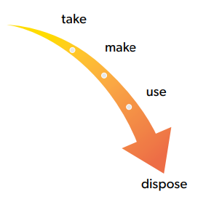
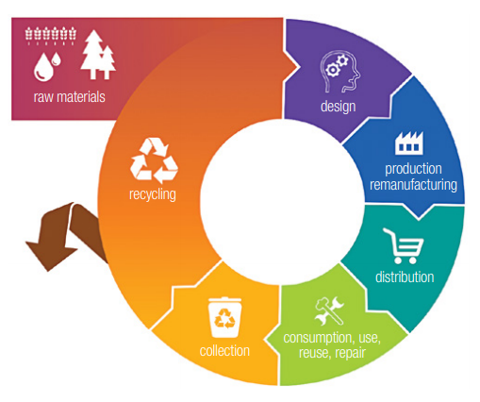
Current Status
Desired Out Come
Significant volumes disposed and lost to the economy
Limited recovery and use of renewable materials and energy
Linear flow of materials
Increase in material recovery and recycle rates
Circular Flow of materials

Slide 8
DATA PIPELINE
1
2
3
4
5
6
1
2
3
4
5
6
Business
Question
Data Acquisition
EDA & Prepossessing
Model Training
Report
Evaluation

Slide 9
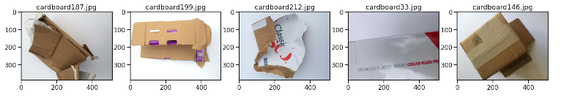
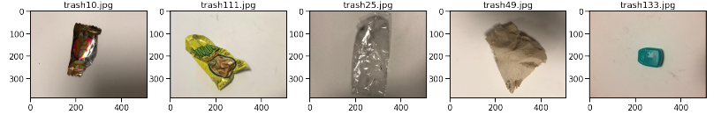
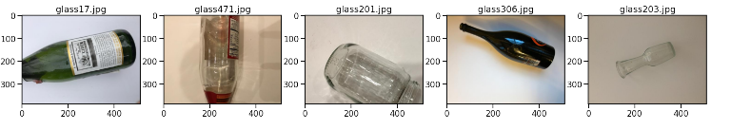
Source: https://github.com/garythung/trashnet/tree/master/data
by Gary Ching and Mindy Yang, Stanford University
DATASET
2100 images
6 classifications:
cardboard
glass
metal
paper
plastic
trash

Slide 10
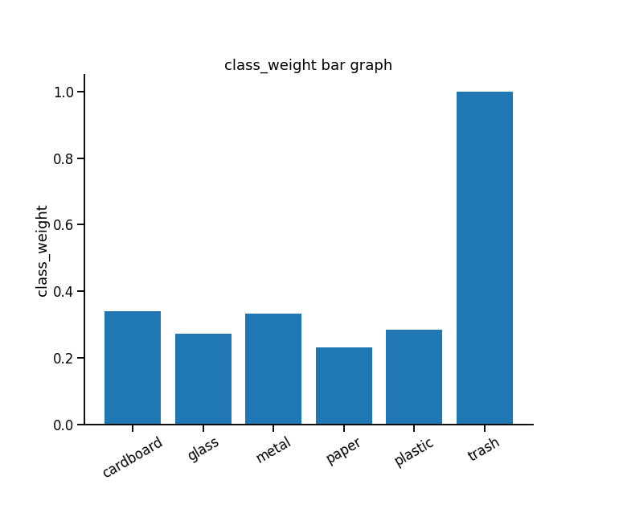
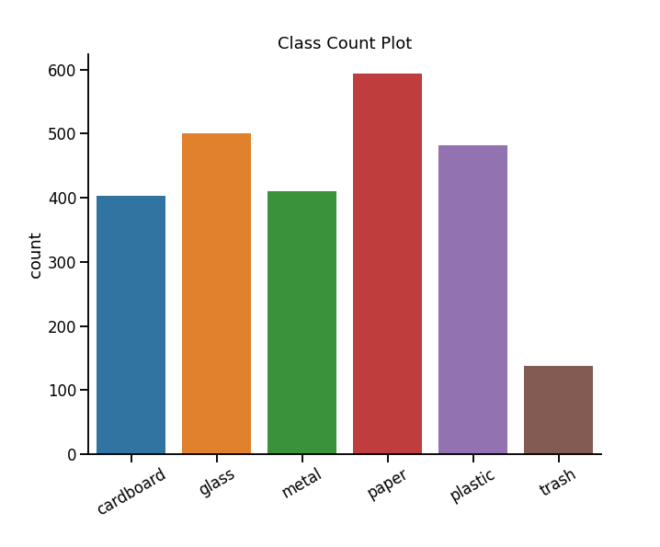
EDA
Slight imbalanced dataset
Inverse Number of Samples (INS) used to determine class weights for model training

Slide 11
Image Preprocessing
Read Image
Format Data
Split Data
Image Augmentation
CV2 to read image files
Resize to 150X150X3
Convert to NumPy array
‘float32’
Normalize image array
train_test 80:20
Stratified split
ImageDataGenerator
rotate
width_shift
height_shift
horizontal_flip
vertical-flip

Slide 12
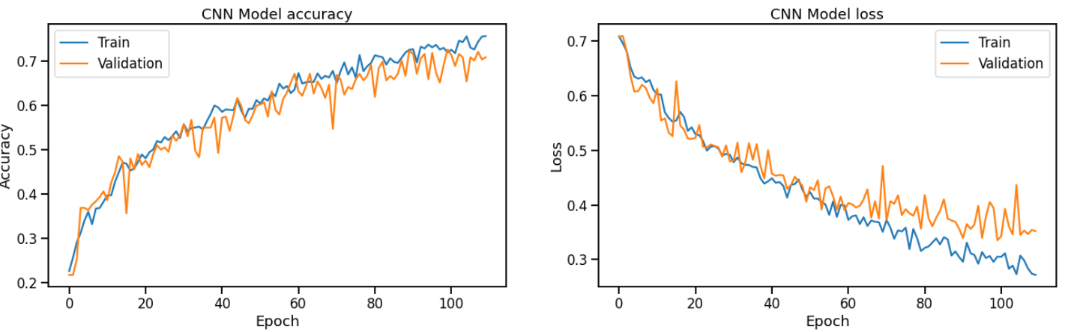
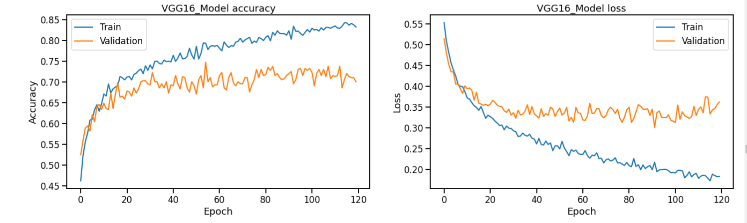
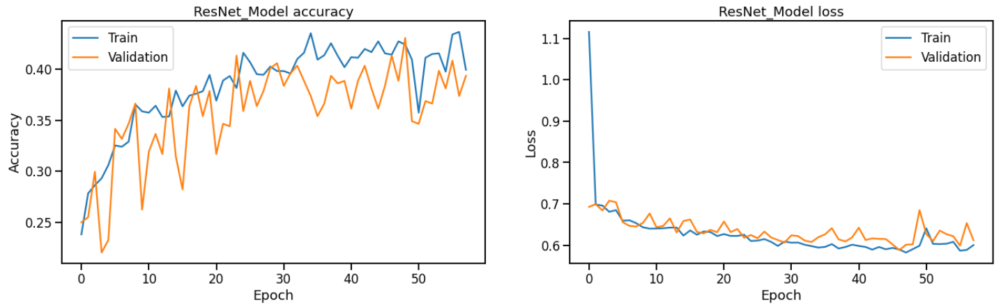
Model Training
Model fitting
120 Epochs
Early stopping, monitoring ‘loss’
CNN – 18 layers
Early stop at 110 epochs
VGG16 – Transferred learning
Completed 120 epochs
ResNet50 – Transferred learning
Early stop at 58 epochs

Slide 13
Model Evaluation
Model | accuracy_score | roc_auc_score
VGG16 | 0.7549 | 0.9442
CNN – 18 Layers | 0.7430 | 0.9263
Resnet50 | 0.4308 | 0.4640
Models ranked in
order of roc_auc_score

Slide 14
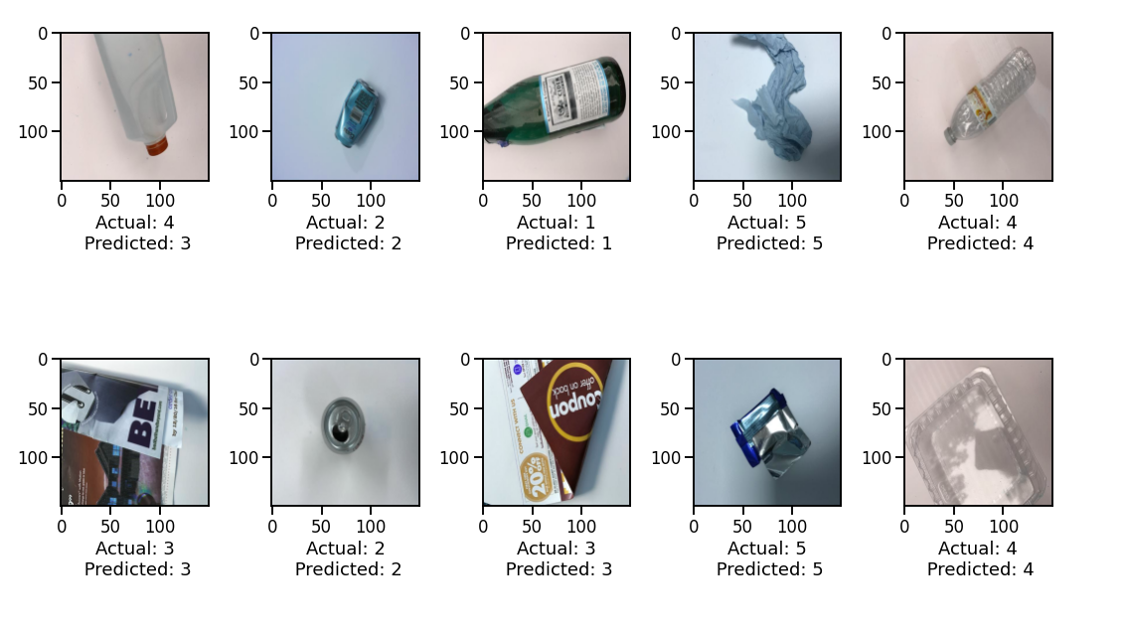
Model Predictions
KEY
0 – cardboard
1 – glass
2 – metal
3 – paper
4 – plastic
5 – trash

Slide 15
Next Steps
material handling and recycle facilities handle a stream of waste rather than single objects
further model development to object detection of a live video stream
Model Application in
Waste monitoring, compliance and quality control
Automated Sorting
Smart Bins and Trucks

Slide 16
Summary
Multi classification model with an accuracy of 94% was developed for waste classification
Model was successful as it accurately predicted unseen data/images
Further development to object detection required for a production ready model
$300 billion saving to Australian economy from nominal recovery of 25% recyclable material to landfills

Slide 17
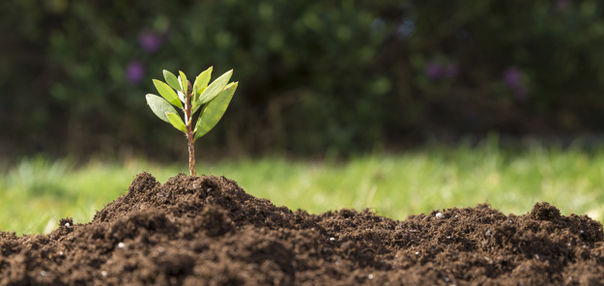
THANK YOU

